Slide 1

Music Recommendation Service
Group 2: Jason Ingram & Isaiah Martinez
Notes:
1. Table of contents
2. Introduction
3. Quote
4. Study objectives
5. Literature review
6. Schedule
7. Methodology
8. Table
9. Results analysis
10. Conclusions
11. Bibliographical references

Slide 2
Table of contents
01
03
02
04
Project
Design
Data
Visualization
Web
Crawlers
Data Preparation

Slide 3
01
Project Design

Slide 4


Project Description
Music Recommendation Service:
2 Web Crawlers
2 User Data sources
Sources for User Data

Slide 5

Webcrawler Design
Snowball effect for Artists
Snowball Effect for genres

Slide 6
Project Design
User Data Music Data
Music Recommender
Combined
Dataset

Slide 7

02
Web Crawlers

Slide 8

Web Crawler Design
Isaiah
Music Map
Last.fm
Script
Holds Song Information
Obtains Related Artists to a given Artist
Stores data across several files

Slide 9
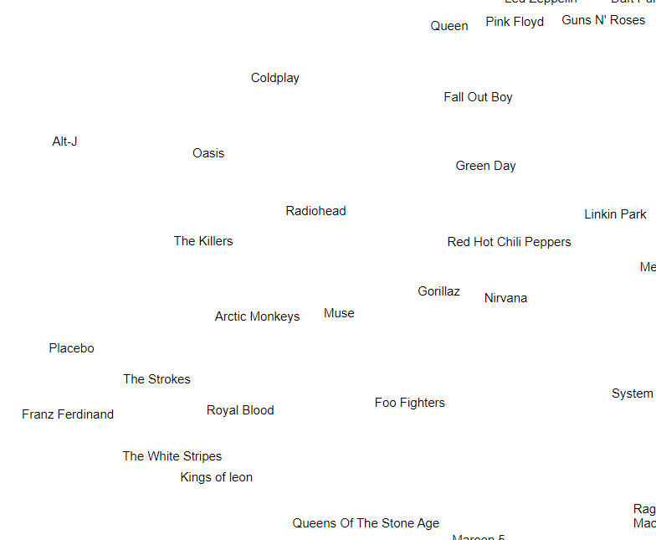
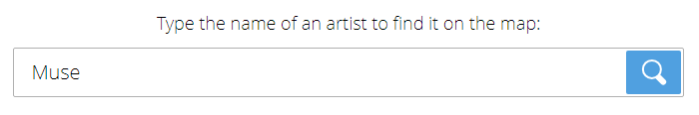
Music Map
Artist Name to search on music-map.com

Slide 10
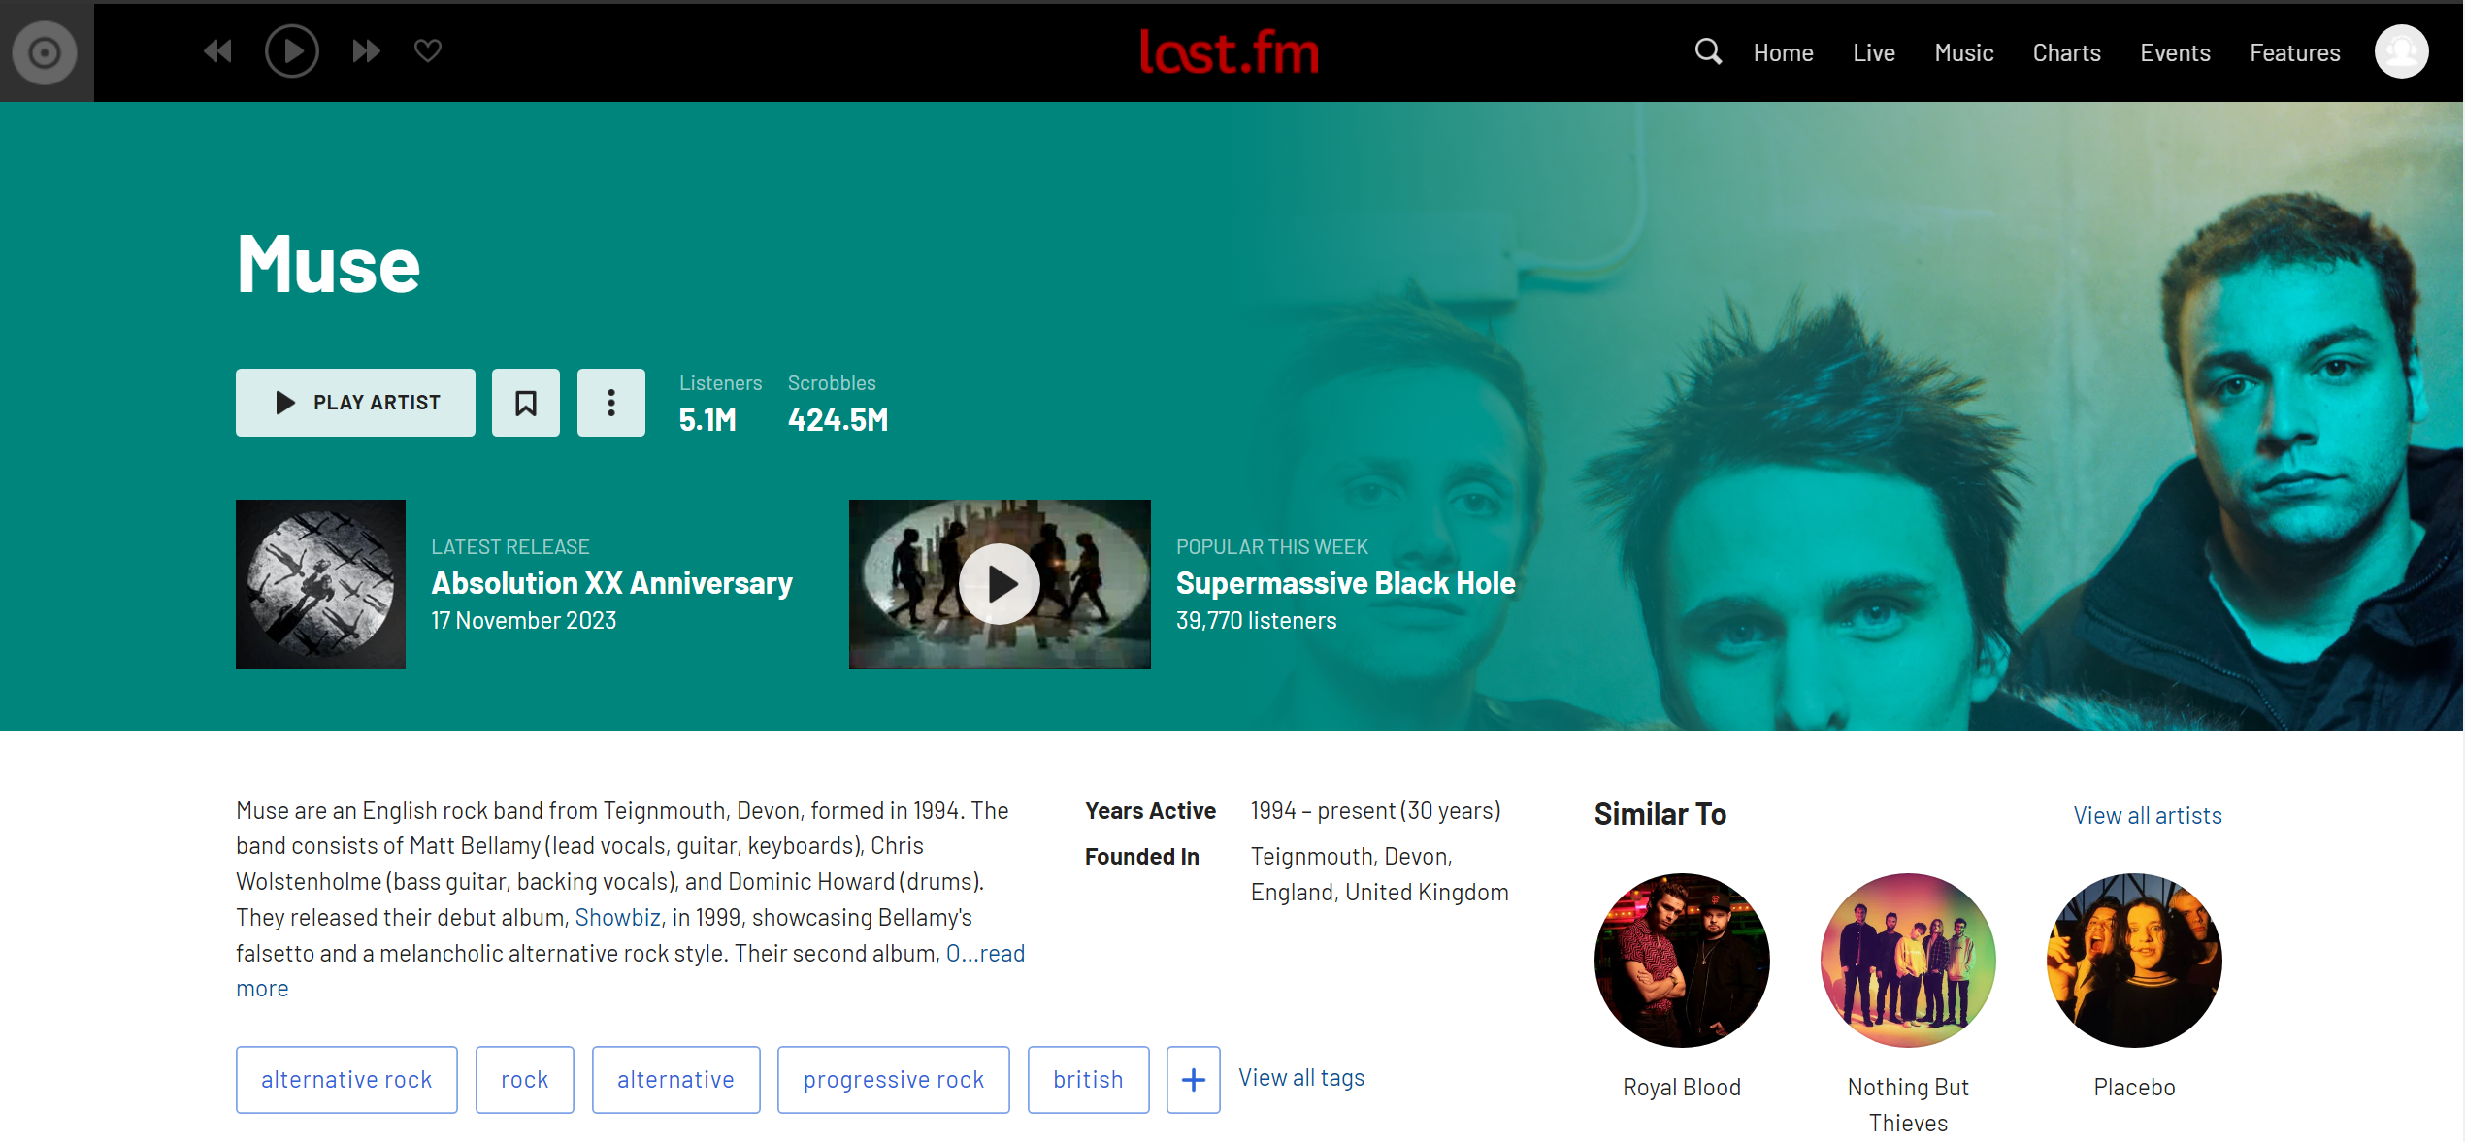
Last.fm
Artist page

Slide 11
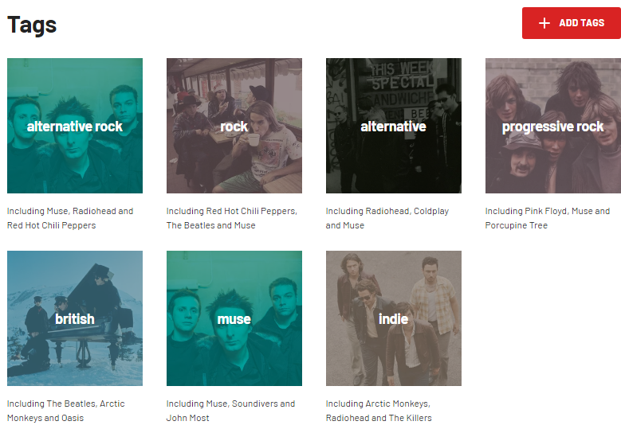
Last.fm
View all Artist Tags

Slide 12
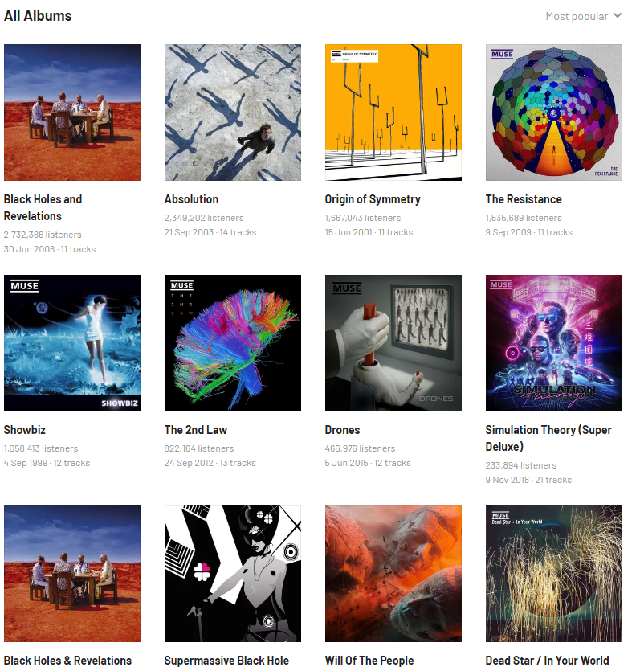
Last.fm
Collect all albums

Slide 13
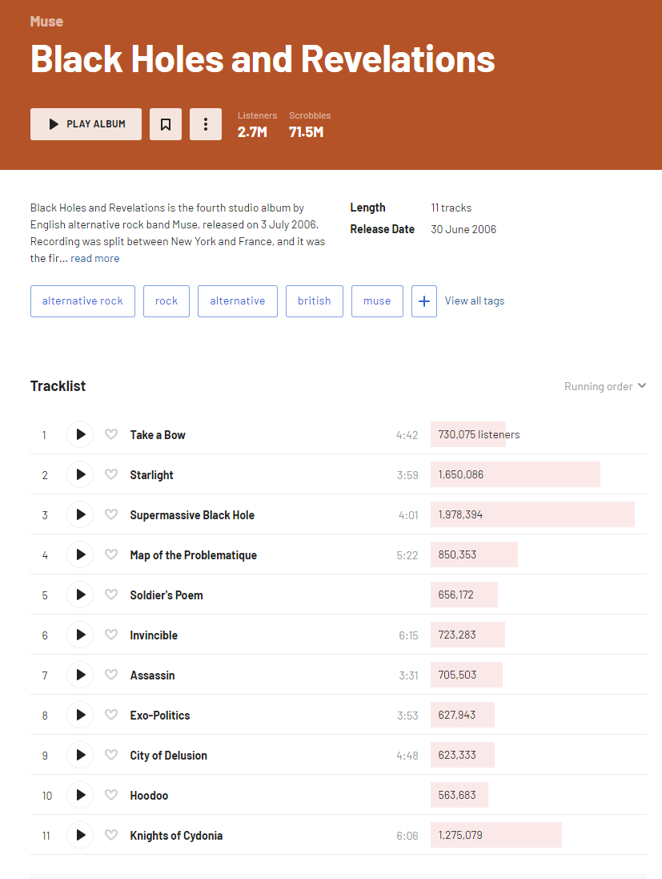
Last.fm
Desired information:
Album Name
Release Date
Album Tracklist

Slide 14
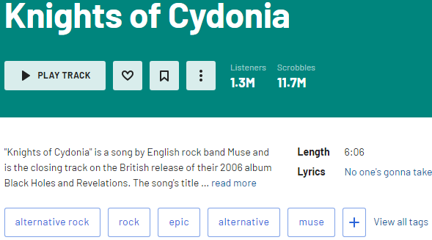
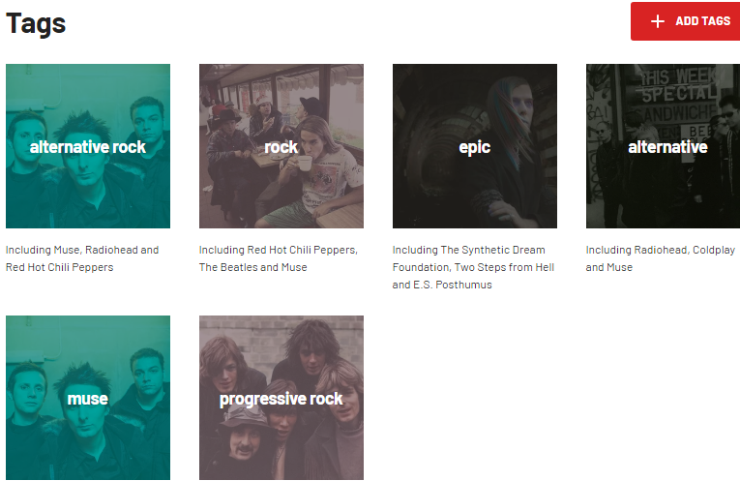
Last.fm
Song Length
Song Tags

Slide 15
Web Crawler Design
Jason
All Music
Script
Holds Genre and Song Information
Stores data into a csv

Slide 16
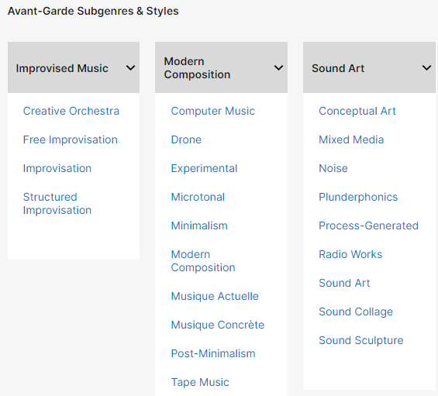
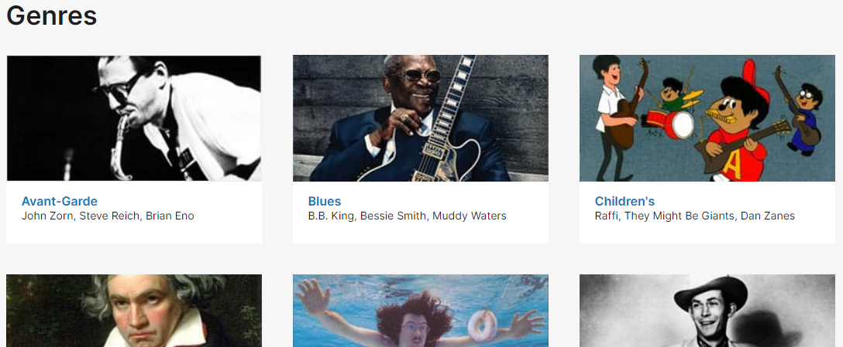
All Music
All Genres
All Sub-Genres

Slide 17
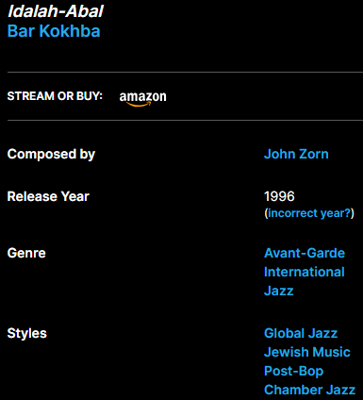
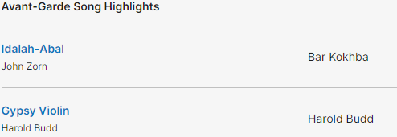
All Music
All Songs
Song Information

Slide 18
03
Data Visualization

Slide 19
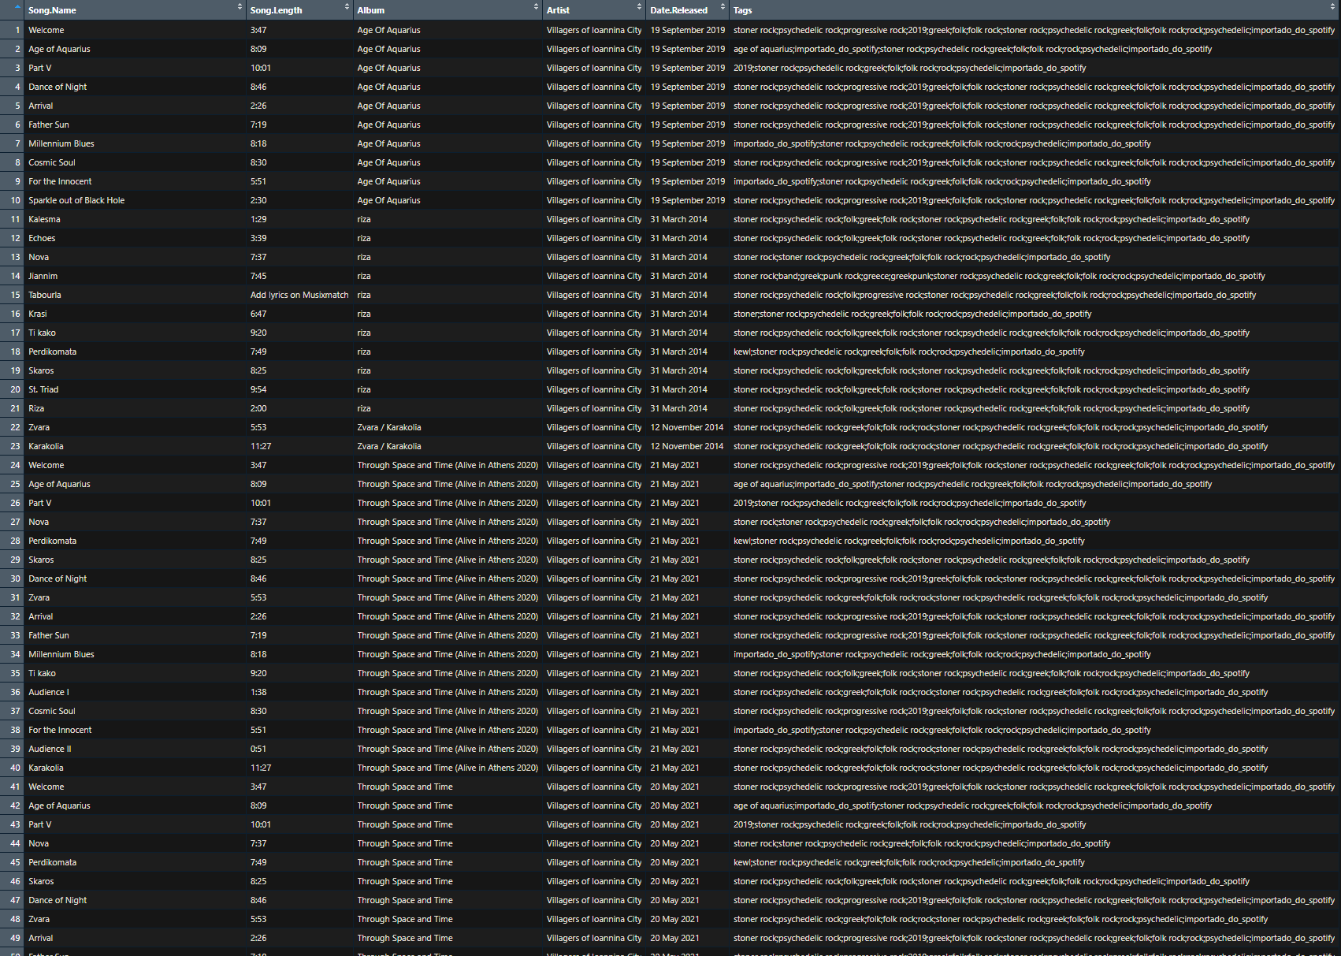
Dataset
CSV file combined and imported into R

Slide 20
> 200,000
Total Songs with information
coming from 288 artists from various genres

Slide 21
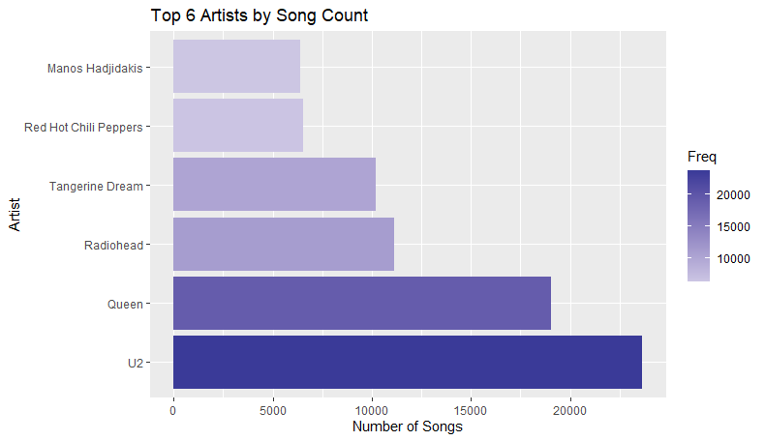
Top Artists by Song Count

Slide 22
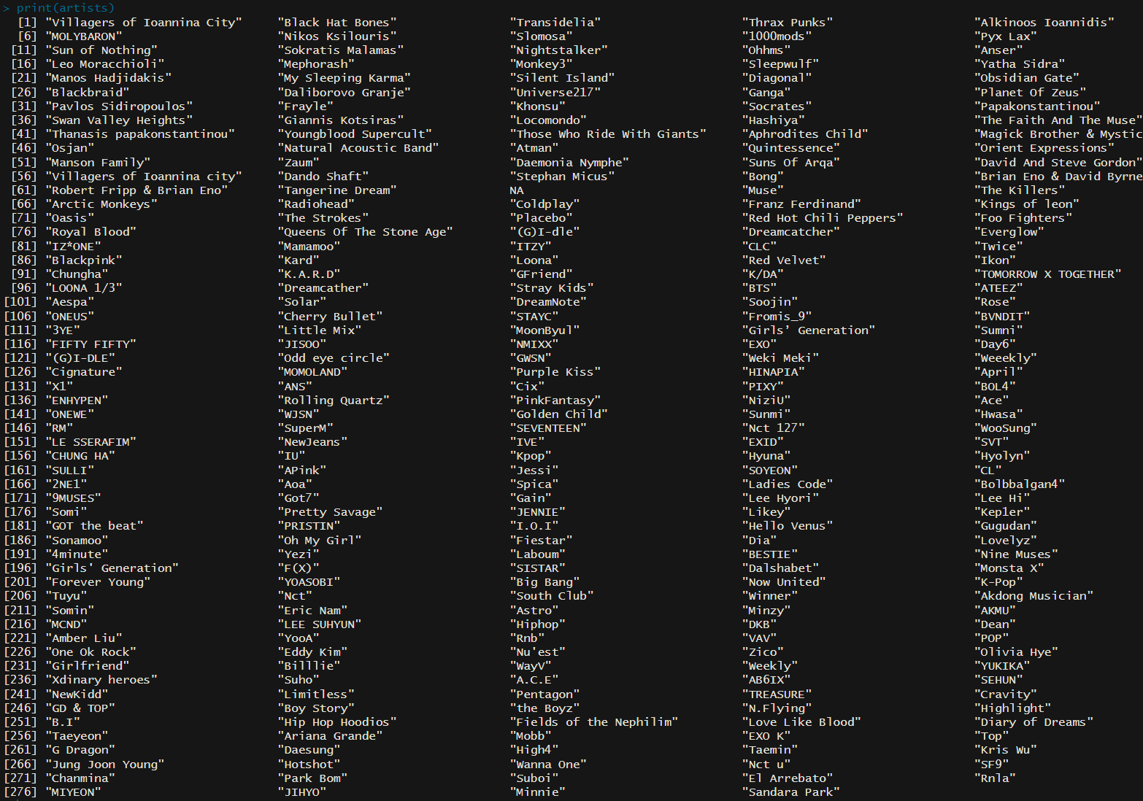
Unique Artists
Over 200 artists obtained

Slide 23

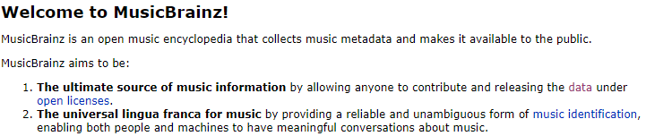
Song Relation Data
Holds Song Relational Data

Slide 24
04
Data Preparation

Slide 25
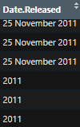

Data Cleaning
Non-genre tags
Some release dates
only give the year while others give the exact date (DD/MM/YYYY)

Slide 26
Data Cleaning Solutions
Compare the tags for songs against list of genres
Only leave those that exist in the list. Remove all others

Slide 27
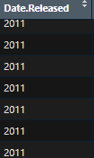
Data Cleaning Solutions
Take the dates extracted
Only leave those with the
4-digit year

Slide 28
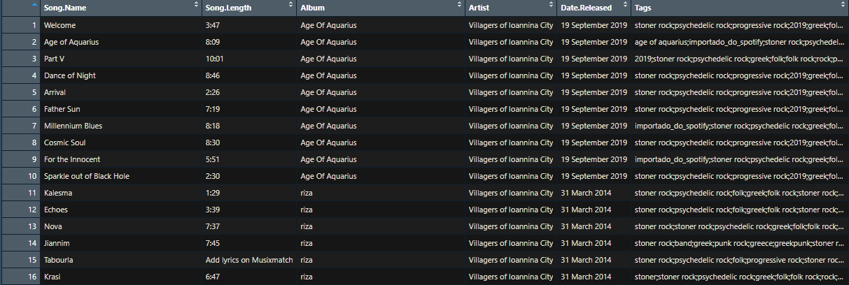
Pre-Clean
First 16 rows of data

Slide 29
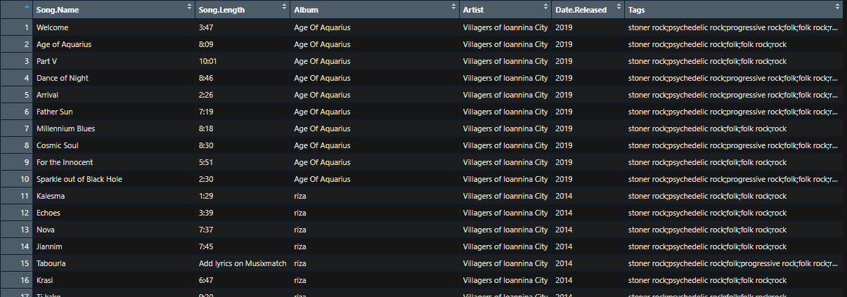
Post-Clean
First 16 rows of data

Slide 30
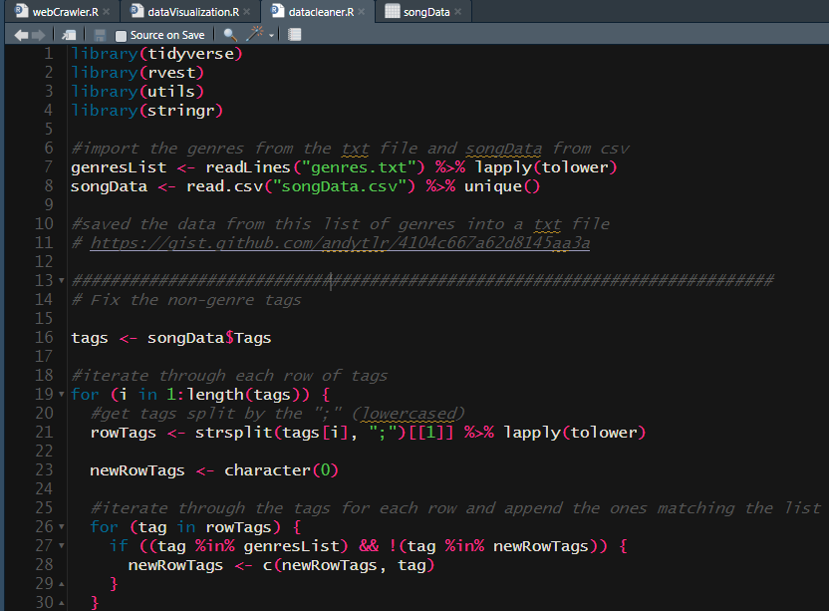
Post – Cleaned Data
Handled by datacleaner.R
2 parts:
Fix non-genre tags
Change release dates
datacleaner.R Script

Slide 31

Questions?
Thanks for Listening

